Slide 1
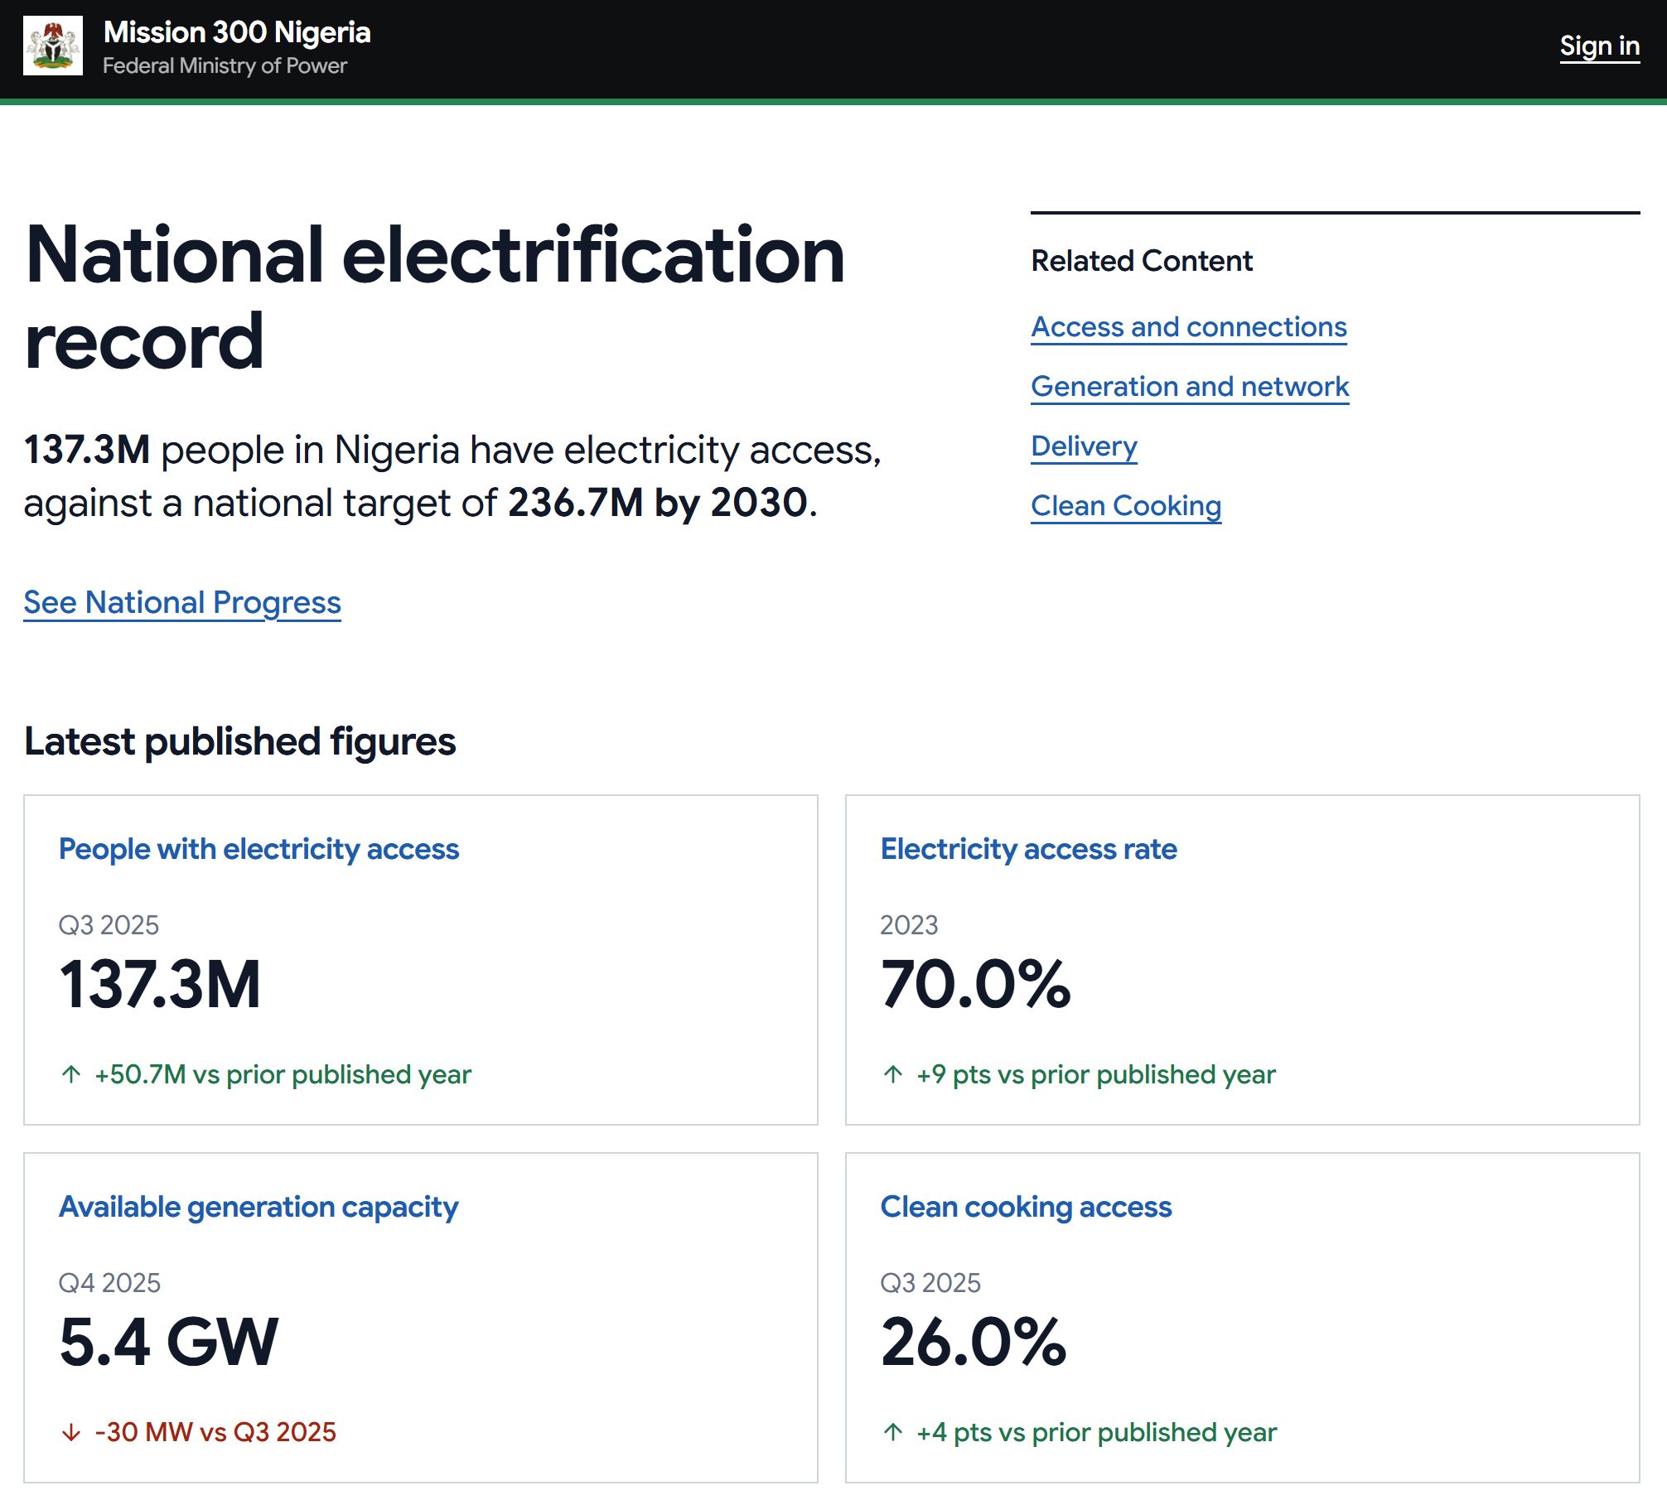
1
2
3
Notes:
URL: http://localhost:5173/
Comments:
Use the full platform name: “Coutry - Mission 300 Compact Progress Monitoring Platform” or similar
This section occupies valuable screen real estate and doesn’t provide value in terms of disseminating information; consider moving the headline numbers up higher and squeezing this below them.
Instead of latest published figures use something else more descriptive e.g. “M300 Progress at a glance” and move the cards up higher in the screen.
General: the prominent features of the landing page should be the progress cards and the section on compact pillars - these should be visible without having to scroll down the page if possible; the related content, who reports these figures and about these figures should be like footnotes.

Slide 2
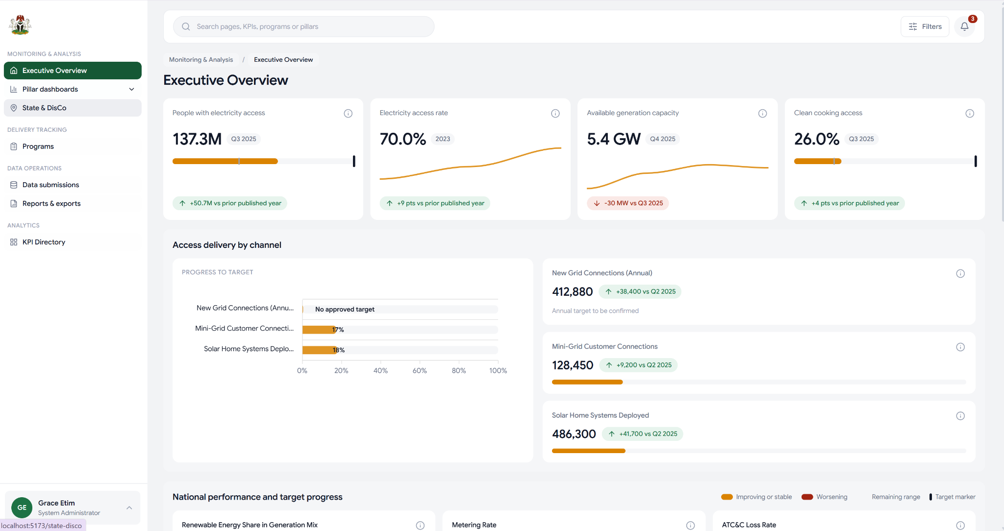
1
4
2
3
Notes:
URL:http://localhost:5173/dashboard
Comments:
Huge white space here after the logo isn’t visually appealing; include the platform name instead.
This is a very good feature, having these trend narrations is amazing!
Is clean cooking not being tracked here as well? Instead of the chart on the left, the cards on the right make more sense - it should also track the progress against target - imagine this section being 4 cards looking at access delivery by the different channels and focused on what’s been delivered against target and still retaining the trend narration in the green pills. Also calling out that I like that hovering over the info icon brings up metadata about that record - most importantly the definition, methodology, data source and date of last update.
The filters logic is missing, nothing shows up when you click it - the CDMU had very specific filtering feedback in one of the previous calls - be sure to seek that and implement accordingly.

Slide 3
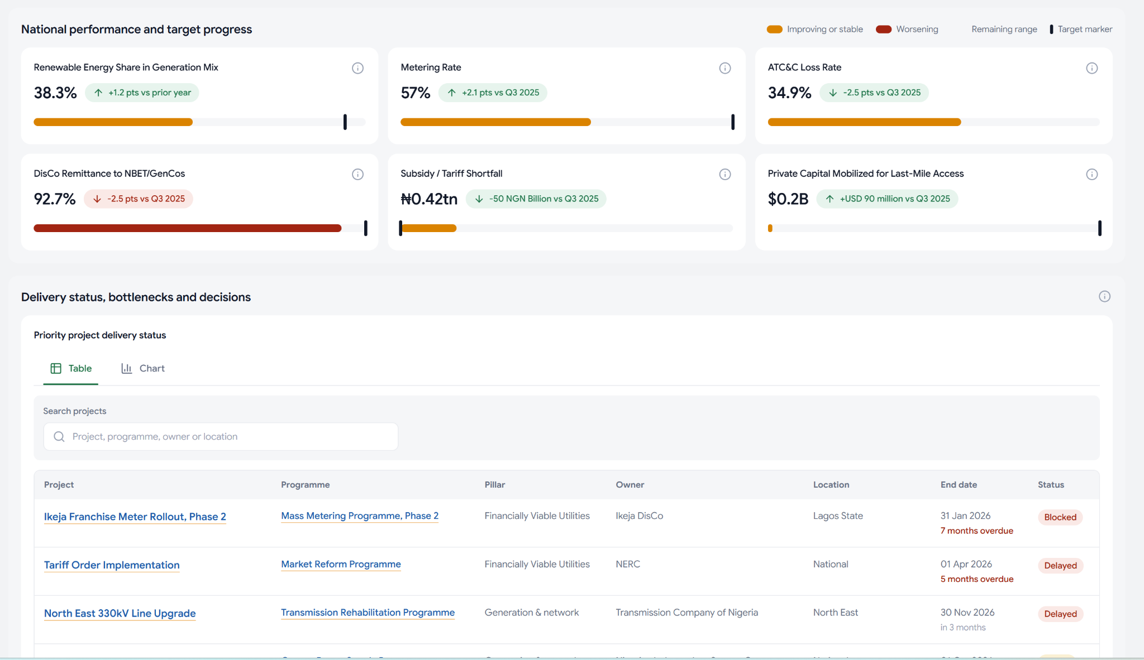
1
2
3
Notes:
URL: http://localhost:5173/dashboard
Comments:
This is the implementation i was suggesting in the previous section - a card with current level, target, trend narrative and the the metadata on the info link. A small note on the target: target should have a date as well- e.g. target 100% disco remittance rate by 20XX; this information should all be loaded dynamically from a master KPI reference and editable from the UI incase there are changes down the road.
Do not hard code the currency symbol - ensure this is something that’s loaded dynamically with the field data so that we can change this easily when extending this platform to a different country. I.e whenever monetary values are quoted, the currency information is also loaded and correct symbol loaded dynamically.
This table needs a filter and sort function for it to be useful: filter by: status,owner,pillar, location etc. sort by: end date etc.

Slide 4
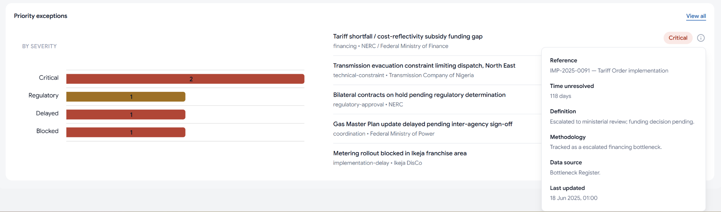
3
1
2
Notes:
URL: http://localhost:5173/dashboard
Comments:
This should probably be a table instead of a list, with the filter, sort and search functionalities discussed in the previous section. Viewing and understanding where bottlenecks are is a very important thing!
Some of the info in the metadata especially time unresolved and definition are very important and should probably show up on the table itself
Test a different visual here, these bars do not seem to communicate that effectively - also the name of this section doesnt make sense - Priority Exceptions ?? suggest a different title - perhaps focused on the bottlenecks/ blockers

Slide 5
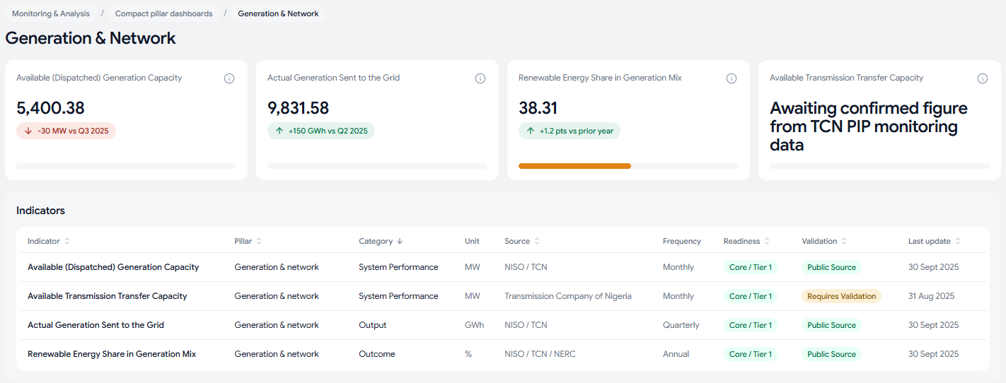
1
2
Notes:
URL: http://localhost:5173/pillars/generation-network
Comments:
This section should be the most important indicators under the specific pillar
Add a filtering function to this table; All tables should have sort (order by) and filter capability ; Also is this just a repitiion of the above cards? It would be more useful to have the projects / programs under that pillar show up here instead.

Slide 6
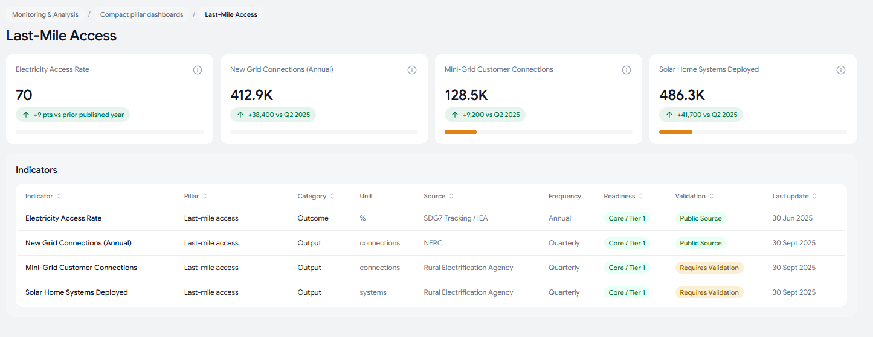
1
2
Notes:
URL: http://localhost:5173/pillars/last-mile-access
Comments:
Targets should be converted to the same unit as the indicator if it isn’t ( I expect them to be) - in this example for instance the indicator is measuring access rate whereas the target is measuring a rate of increase in access, it therefore appears as though there’s no target.
Same comment as before

Slide 7
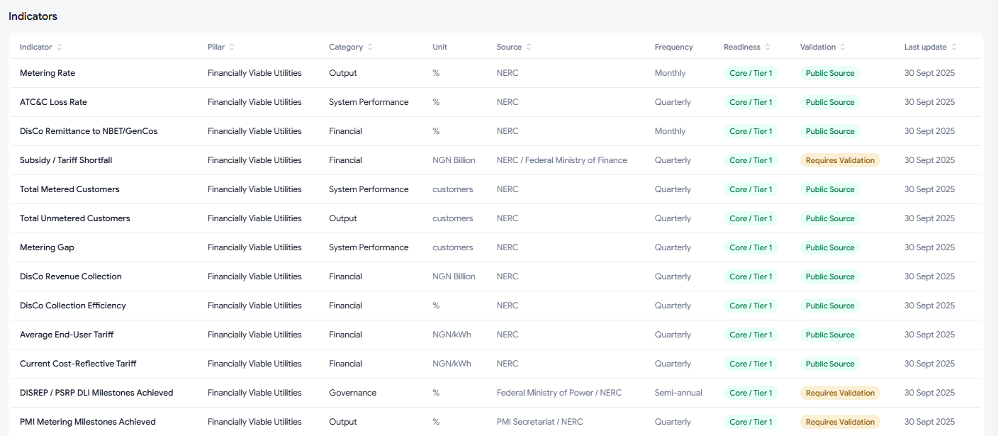
1
Notes:
URL: http://localhost:5173/pillars/financially-viable-utilities
Comments:
I don’t understand this table - is it just showing metadata about the financially viable utilities indicators? I don’t think that’s needed. Would be more helpful to have a table with disco level indicators instead, so that the cards above this provide aggregate information on utility financiall performance and then table provides a disco-by-disco breakdown.

Slide 8
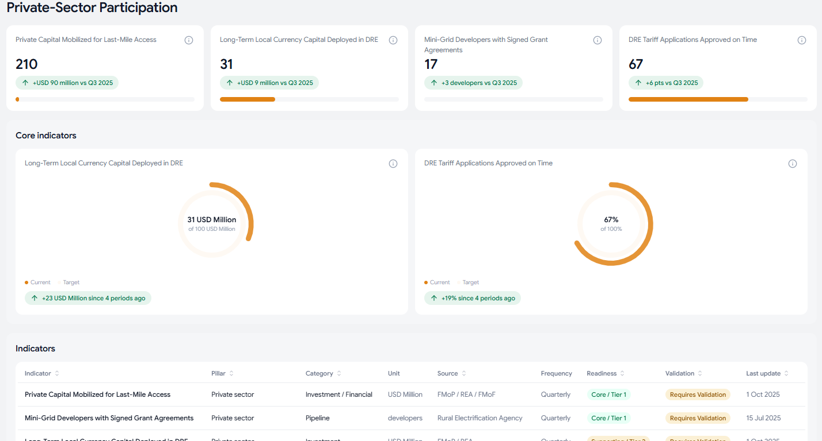
1
2
Notes:
URL: http://localhost:5173/pillars/private-sector-participation
Comments:
I don’t see the value addition of this section - it repeating the exact same information in the topline cards above ( with a slightly confusing chart) ; reconcile and no need to waste real estate with the same info twice - could use it instead for other indicators that are not- the core 4 on the top.
Same comment as table on financially viable utilities: is it just showing metadata about the private sector participation indicators? I don’t think that’s needed. Would be more helpful to have a table showing the various projects / announcements etc - whatever contributed to the aggregate information in the cards above.

Slide 9
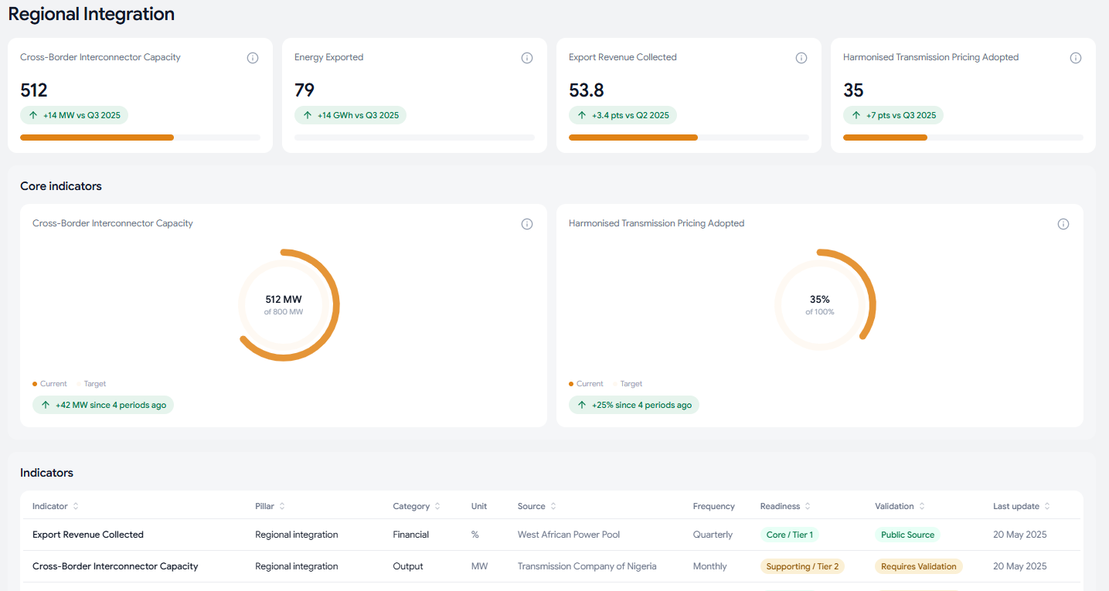
1
2
Notes:
URL: http://localhost:5173/pillars/regional-integration
Comments:
I don’t see the value addition of this section - it repeating the exact same information in the topline cards above ( with a slightly confusing chart) ; reconcile and no need to waste real estate with the same info twice - could use it instead for other indicators that are not- the core 4 on the top.
Same comment as table on financially viable utilities: is it just showing metadata about regional integration indicators? I don’t think that’s needed. Would be more helpful to have a table showing the various projects / announcements etc - whatever contributed to the aggregate information in the cards above.

Slide 10
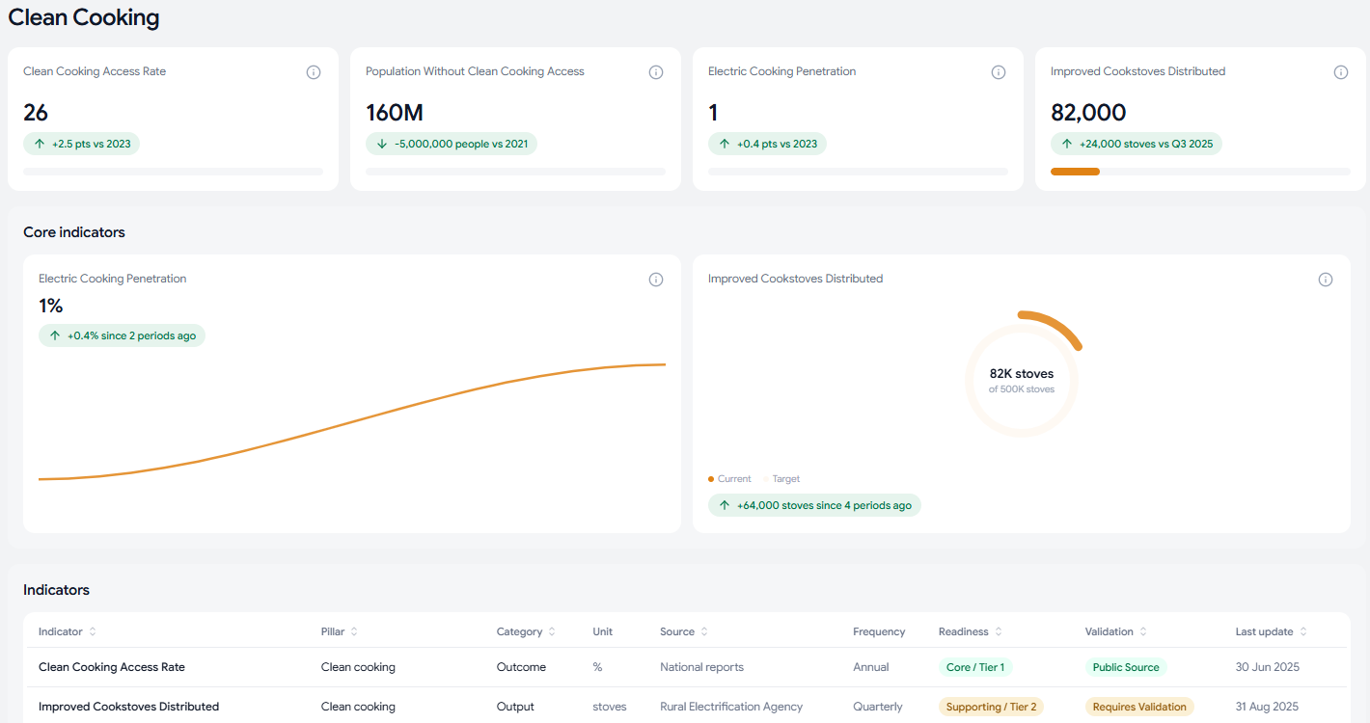
1
2
Notes:
URL: http://localhost:5173/pillars/clean-cooking
Comments:
I don’t see the value addition of this section - it repeating the exact same information in the topline cards above; reconcile and no need to waste real estate with the same info twice - could use it instead for other indicators that are not- the core 4 on the top.
Same comment as table on financially viable utilities: is it just showing metadata about clean cooking indicators? I don’t think that’s needed. Would be more helpful to have a table showing the various projects / announcements etc - whatever contributed to the aggregate information in the cards above.

Slide 11
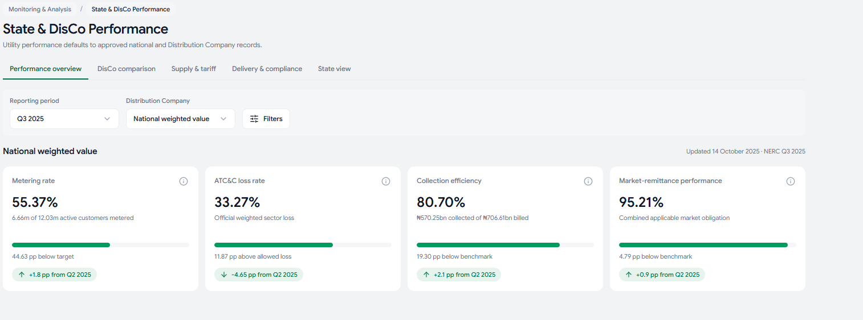
1
Notes:
URL: http://localhost:5173/state-disco
Comments:
I like what i see on this page; filters and tabs for deep dives into specific areas. We could replicate this with the other indicators for other pillars - would make for a vastly more powerful experience. The tables under the tabs implement what i had commented on in previous section - a break down of the numbers contributing to the reported aggregate - the only thing left is to implement sorting on all date fields and filters on all categorical fields; also something important to note, is that filtering fields should also be in the table - as an example on the delivery and compliance tab you can filter by service band, but service band doesn’t show up on the table - so either add it to visible columns on the table or remove it from the filter.
General:
Wondering what the difference in purpose is between this page and the financially viable utilities page under the pilla dashboards:( /pillars/financially-viable-utilities)

Slide 12
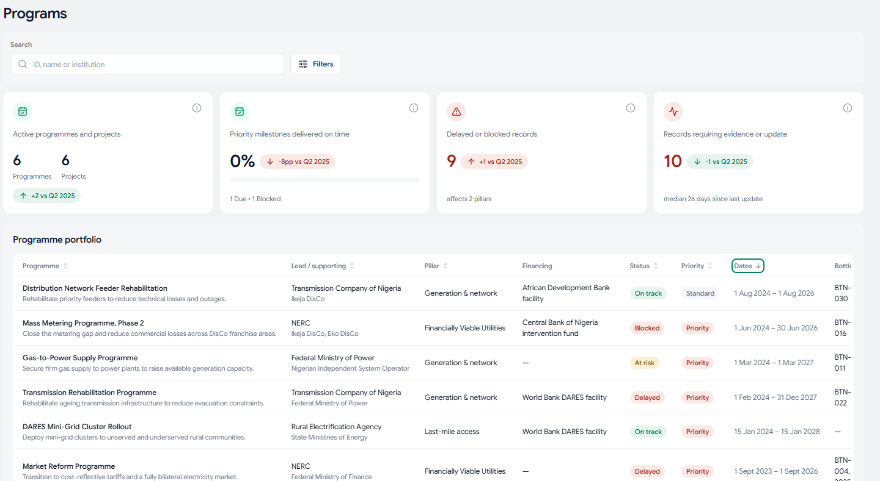
1
Notes:
URL: http://localhost:5173/programs
This page is close to perfect: only comment is to cross link table records e.g. on the portfolio table here, if i click on the bottleneck - it should link to the issue/bottleneck register

Slide 13
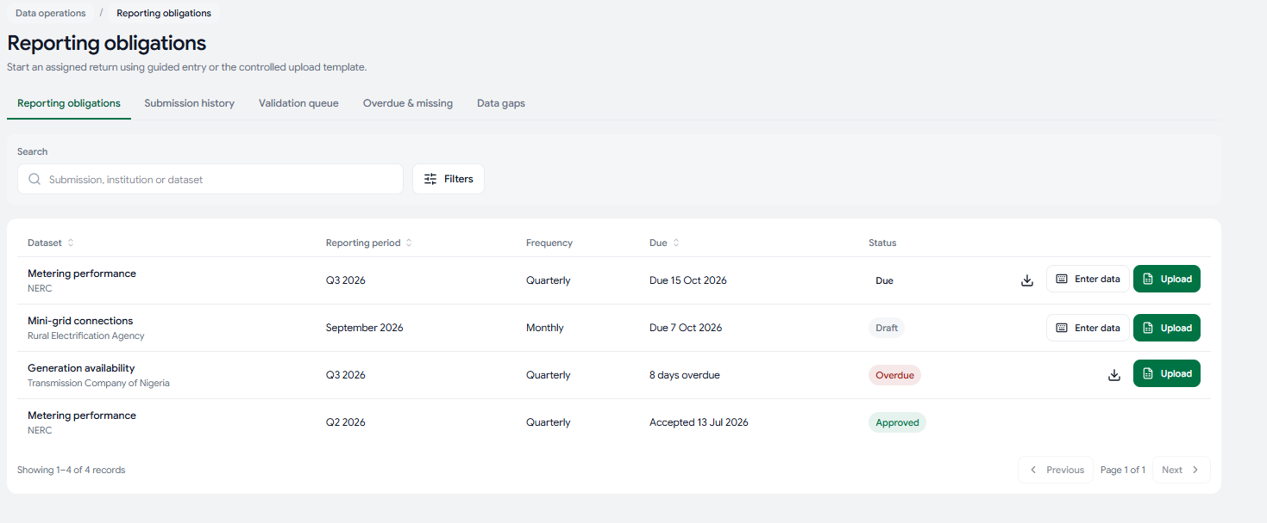
Notes:
URL: http://localhost:5173/data-submissions/obligations
General:
Add a column of the person who is supposed to do the submission for both the reporting obligations and submission history tabs - similar to how the validation queue states the name of the reviewer
Add some aggregate data operations indicators above the table - that can be filtered by dataset/ responsible organization - e.g. count by status; average queue age; average days overdue etc.
Question: on the upload workflow - is there a process to preview before submitting?

Slide 14
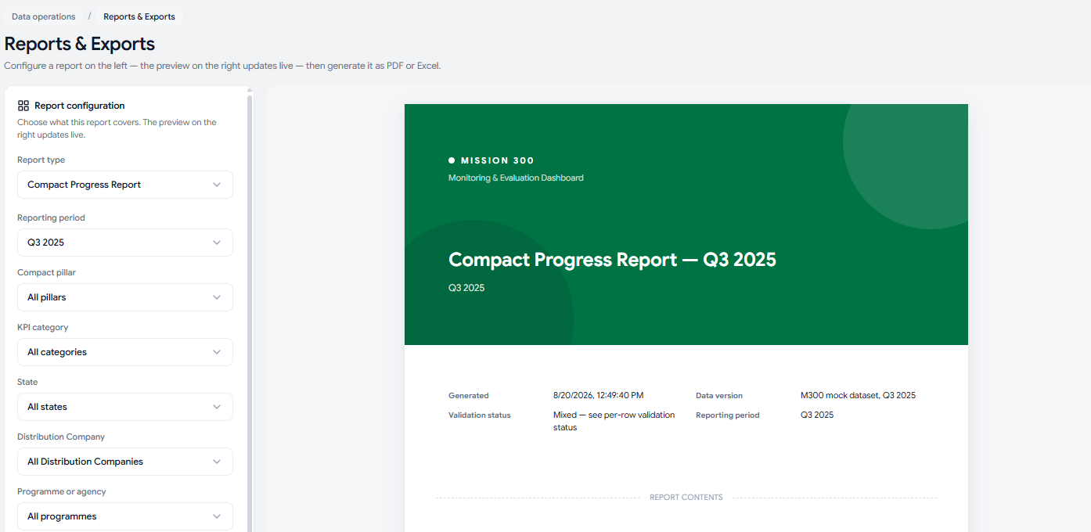
1
2
Notes:
URL: http://localhost:5173/reports
I would appreciate a simple way to generate custom reports - where you can pick which indicators and reporting period etc to include in the report for export - and this custom report can then be saved and used in the future vs only having hard coded choices.
Add logo here ( almost like a letterhead)
General:
Check and test this section with SE4ALL and the CDMU to ensure the reports generated provide the information required by CPR obligations and any other internal reporting obligations

Slide 15
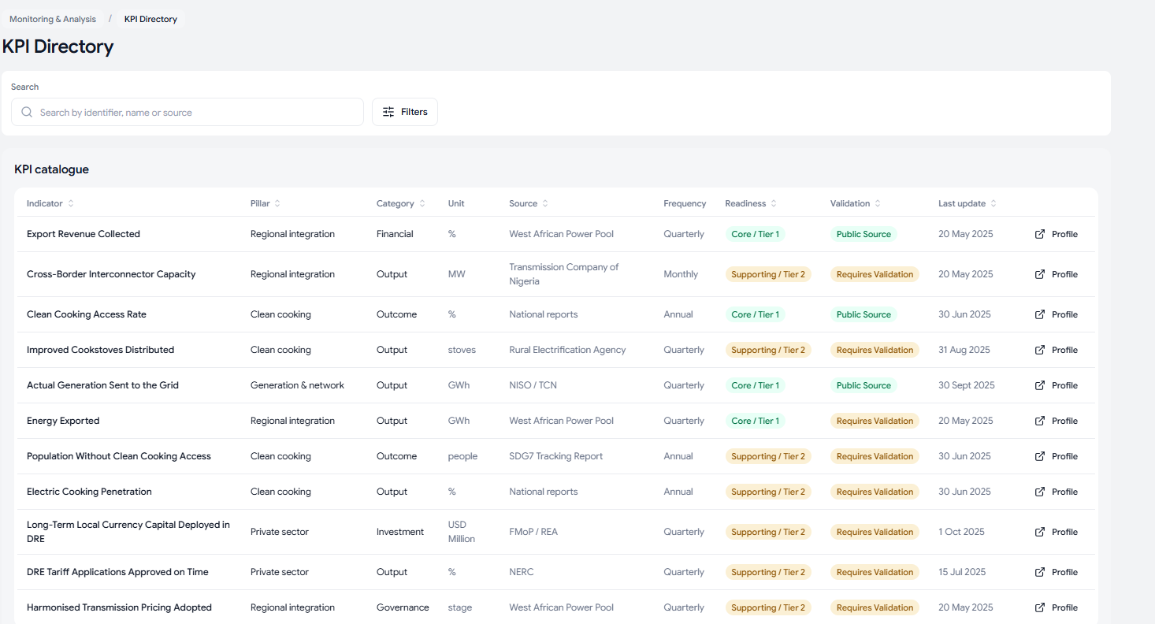
Notes:
URL: http://localhost:5173/data-submissions/obligations
General:
Need to add a workflow for adding new KPIs, existing ones can be modified, definitions changed etc, but we need to have the ability to add extra KPIs or deactivate some.

